Slide 1
e-Doctor
System Analysis and Design Lab

Slide 2
Presented by
Md. Al Gaddafy - 011191212
Md. Rashedul Islam Uzzal - 011191217
Abu Hasib Muhammad Nanzil - 011192094
Mst. Tanzina Hasan - 011162015

Slide 3
Survey Response
For our Project we put some question in a google form and circulates it through social media to get response. We get responses from people of different age and professions.
Age :
7% responses (Less than 18 years)
70% response (Between 18years - 40 years)
23% response (Over 40 years

Slide 4
Survey Response
Occupation :
Student response - 70%
Job Holder response - 20%
Businessman response - 10%
Gender :
Male response - 55%
Female response - 45%

Slide 5
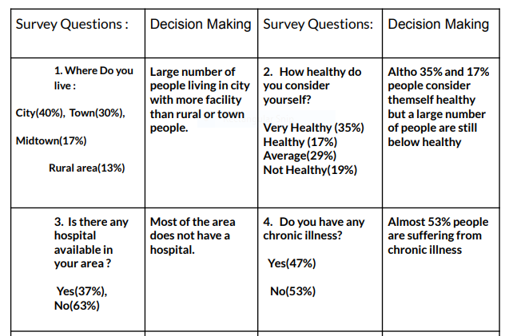
Result Of Survey

Slide 6
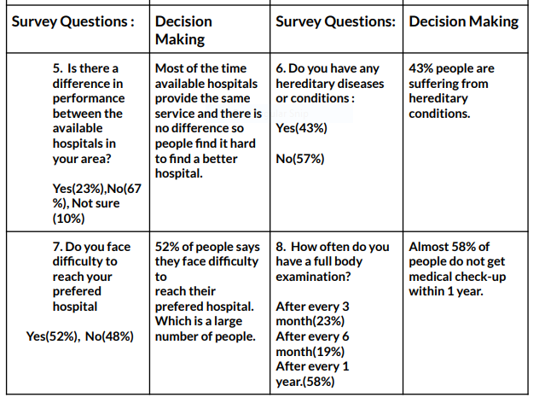
Result Of Survey

Slide 7
Features
Appointment booking
Patients will be able book appointment through online
Instant Prescription
Patients will be able to get prescribed from doctor at any-place.
Individual Profiles
Doctors and patients has their own profiles.
Guidance
Guidelines can suggest how we can take care of ourselves
in concert with our doctors.
Payment gateway
Patient can give payment via online. Like – Bkash, Nagad etc.

Slide 8
SWOT Analysis
Strengths :
Very Time saving process,
patient can get immediate medical information.
In coronavirus pandemic it’s safe to avoid human contact and get medical consultancy.
Payments are very reasonable than physical doctor visit.
Weakness:
For some serious condition this service won’t be enough.
If there is no internet connectivity this service will be no use.

Slide 9
SWOT Analysis
Opportunities :
This type of service will help doctor to help more people .
People will get more efficient help in time.
Threats:
If any patient misunderstood the doctor’s indication over online it could be very dangerous.

Slide 10
Strategy
Our system has limitations. But with time we will improve it.

